Slide 1


CYBR644 – Cyber Practitioner Lab
Spring 2024
University of Maryland, Baltimore County
Michael Hennick

Slide 2
Overview of the course
Week 01 – Introduction, Ethical Hacking Basics, Ethics, Law
Week 02 – Technical Foundations of Hacking
Week 03 – Reconnaissance, Social Media
Week 04 – Scanning and Probing
Week 05 – Vulnerability Identification
Week 06 – Exploiting Weaknesses
Week 07 – Class Presentations / Review for Exam
Week 08 – Spring Break
Week 09 – Midterm Exam
Week 10 – Privilege Escalation, Maintaining Access
Week 11 – Malware, Covering your Tracks
Week 12 – The Web
Week 13 – Wireless and Mobile Security
Week 14 – Physical Security, Social Engineering, and Security Policies
Week 15 – Class Presentations / Review for Exam
Week 16 – Final Exam

Slide 3
review
What is scanning/probing?
Automated method to poke at a target system
- Scan for active systems within a network range
- Probe the active systems for open ports, software in use, and versions
Know how to:
Locate active systems from a network range found during the reconnaissance phase
Find open ports and identify services on active systems
Perform OS fingerprinting on active systems
Map a target network
TCP/IP Primer
TCP Handshake (SYN, ACK, SYN-ACK)
Scanning Tools
Cheops/Autoscan
Zenmap
fping/nmap
WiFi Scanning
Netstumbler
Kismet

Slide 4
Project 1 Reminder
Discuss a network attack/data breach/cyber incident that has been in the news over the past couple years. In your presentation, provide the following:
1. Outline the systems that were attacked and what the weaknesses were (technical, human, or other). Include CVE information if applicable.
2. Identify (if known) the attack tool(s) used in the incident. If not known, hypothesize what the tool would need to accomplish in order to carry out the attack.
3. Discuss what would have prevented or slowed the attack. If the attack is traced to a CVE, include the published remediation/patch information from the vendor and or mitigation that could be implemented.
This presentation should be about 10-15 minutes, which would have been given in class on March 13. The presentation should accompany a paper, approximately 5-7 pages in length.

Slide 5
Where are we?
Phase 1 provided us with information on our target
Network Ranges
Key systems of interest
Technologies Used
Insight into potential attack vectors
Insight into potential passwords
….Now that we’ve walked around the neighborhood and checked out the houses and driveways, let’s jiggle some door knobs and push on some windows…..
Phase 2 provided us additional information on our target
Active systems
Ports/Services
Versions of applications running
Versions of Operating Systems
….Now that we’ve found some open doors and loose windows, lets see if they are in fact access points into the houses….

Slide 6
Scanning for specifics
What if we don’t have network access to the target?
What if we are only interested in Websites or Database servers?
If the port is open, does it mean there is a vulnerability?
If the software providing the service is the latest version, does it mean it is safe?

Slide 7
Vulnerability Identification
What is a vulnerability?
A weakness which allows for an opening for attack
- In a system
- In a protection of a system
Categories:
- Configuration Errors
- Default Configurations
- System Vulnerabilities
Intersection of three elements:
- System susceptibility or flaw
- Access to the flaw
- Exploitation of the flaw
Vulnerabilities can be identified from lists and advisories on common vulnerabilities and also by testing the system

Slide 8
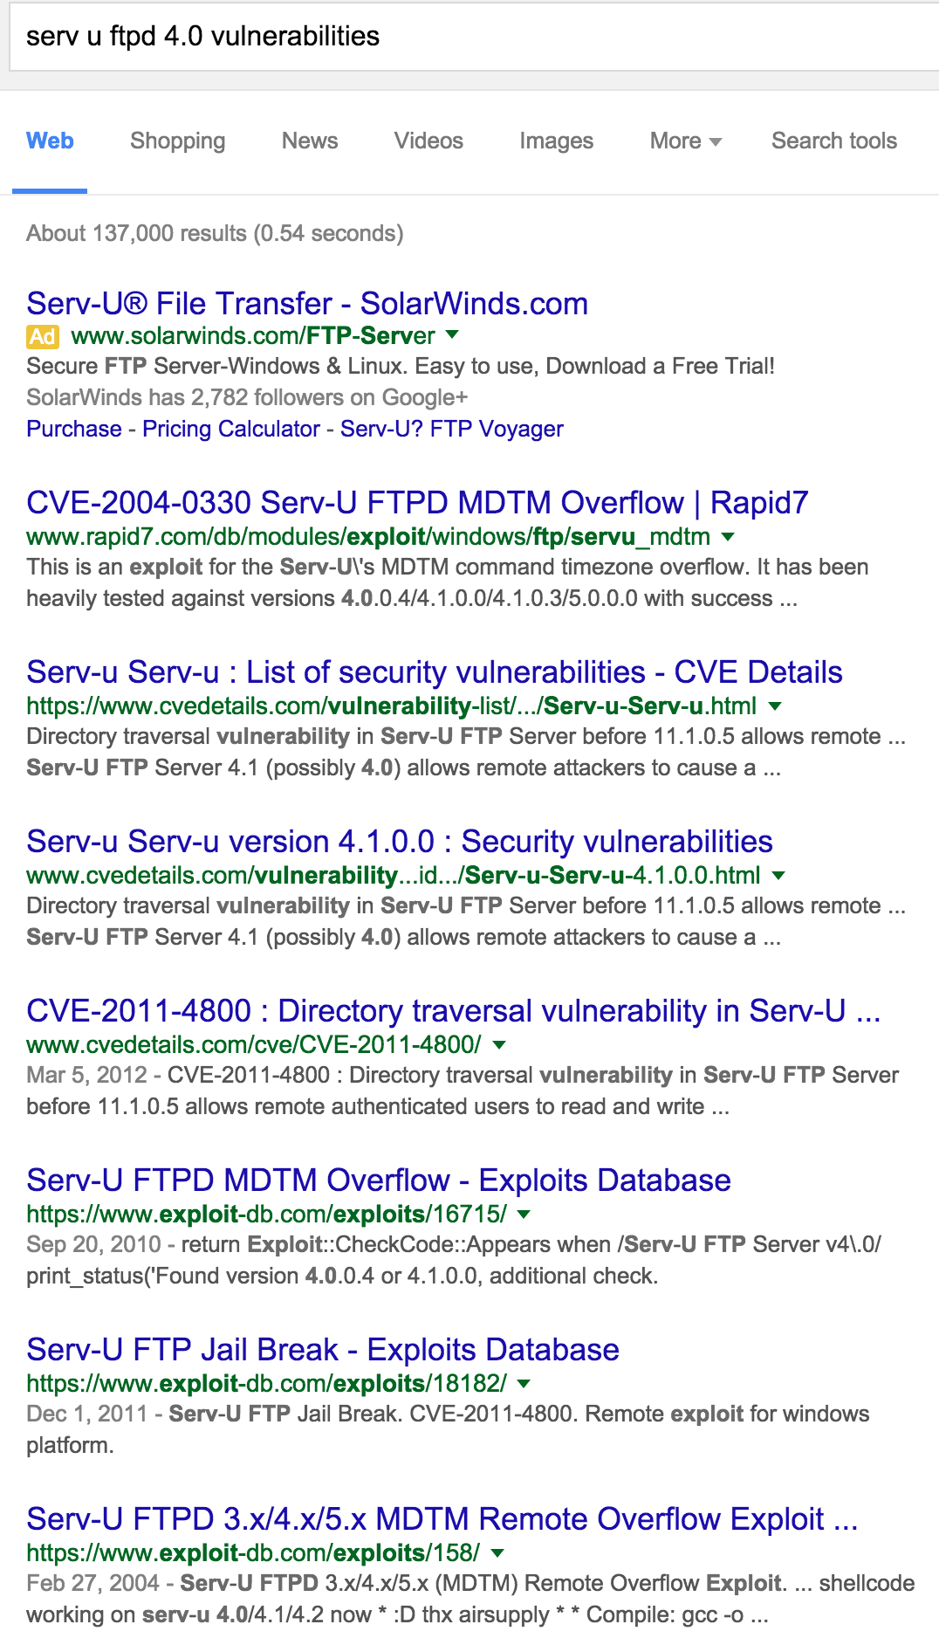
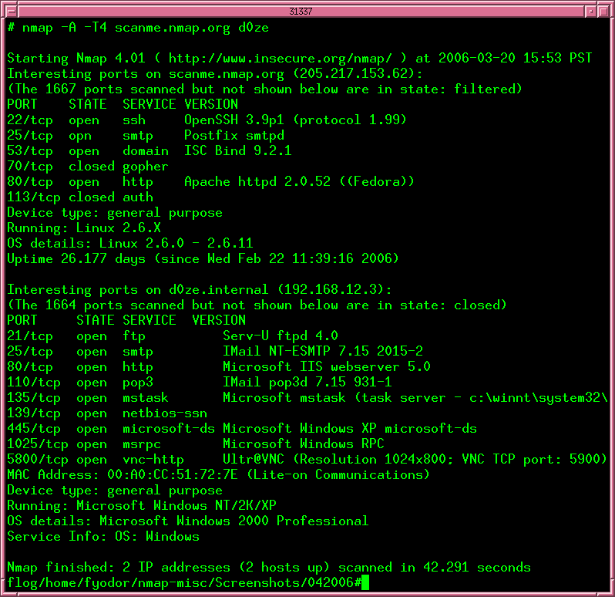
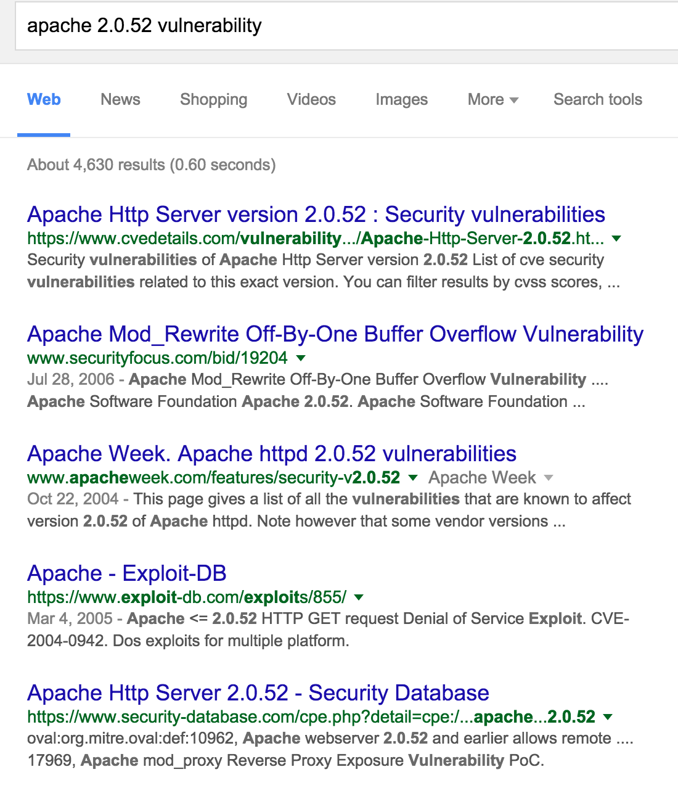
Vulnerability Identification
Getting started manually
NMAP scan using
version detection
Then use google….

Slide 9
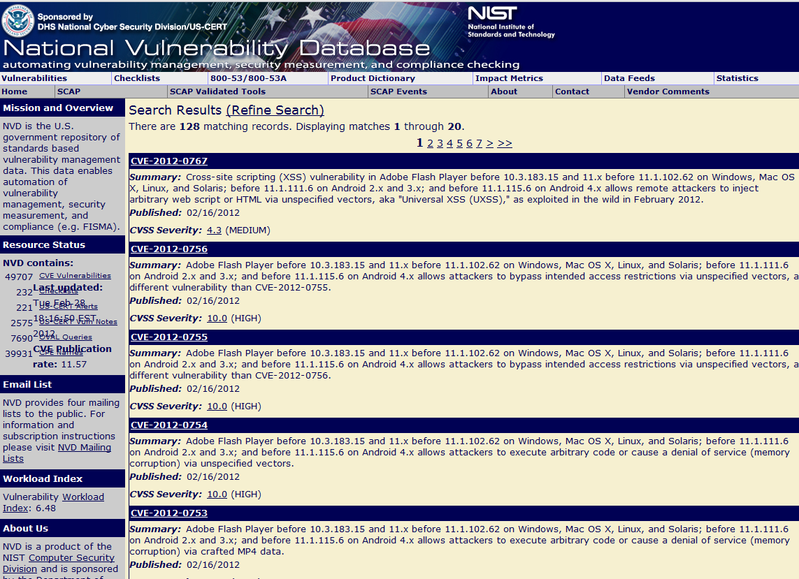
Vulnerability Lists
US-CERT
www.us-cert.gov
SANS ISC
isc.sans.org
SANS Top 20
www.sans.org/top20
Vendor Advisories
Microsoft
Adobe
Cisco
….
NIST Vulnerability Database – nvd.nist.gov
Mitre CVE Database – cve.mitre.org
Open Source Vulnerability Database – www.osvdb.org → No longer a resource

Slide 10
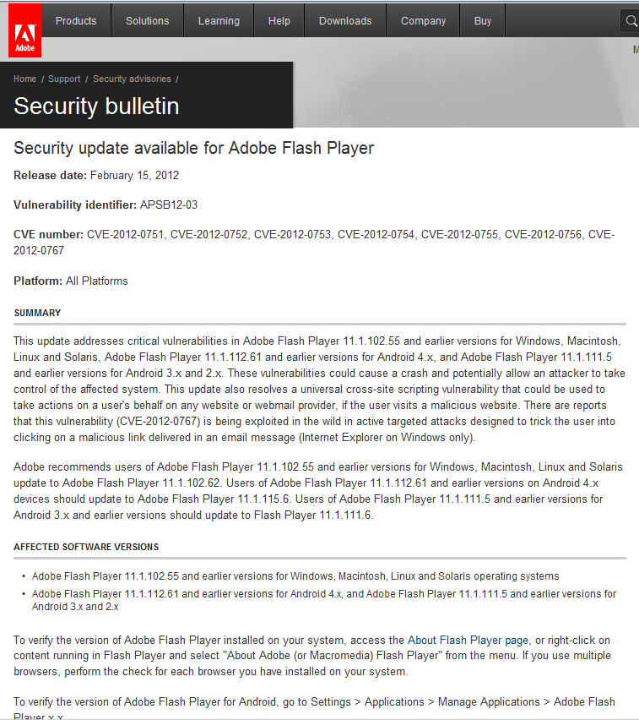
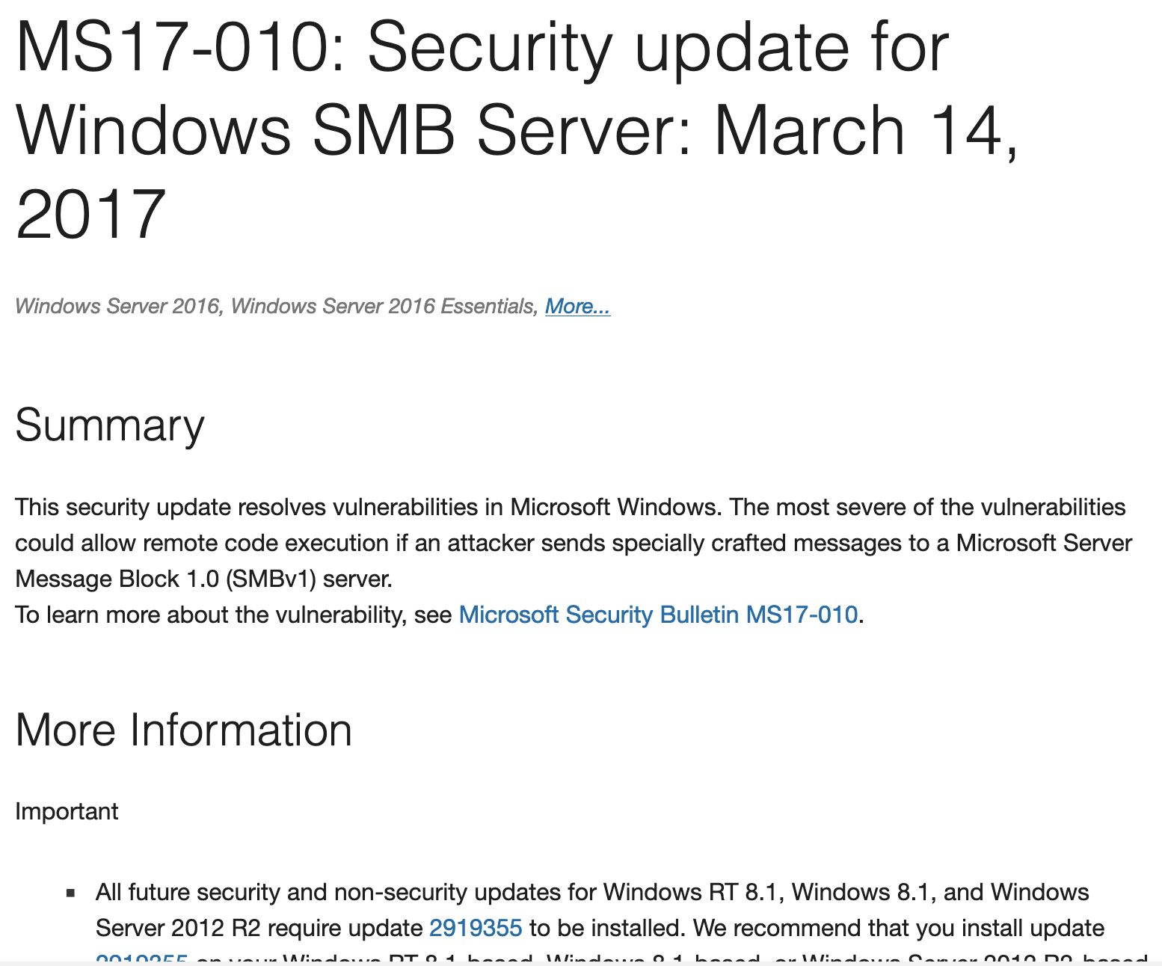
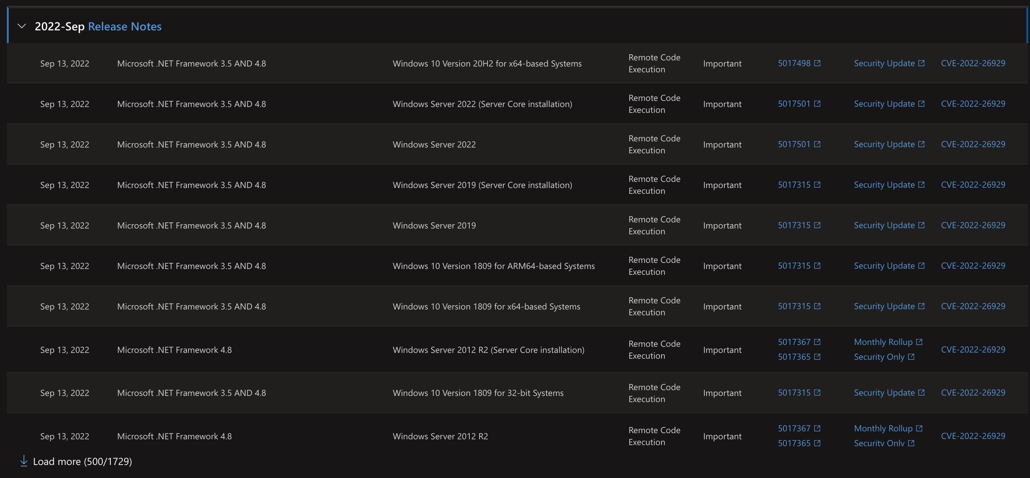
Vendor Advisories
https://docs.microsoft.com/en-us/security-updates/securitybulletins/2017/ms17-010
https://helpx.adobe.com/security/security-bulletin.html
https://msrc.microsoft.com/update-guide

Slide 11
Vulnerability tracking services
Skybox Security Killed
www.vulnerabilitycenter.com

Slide 12
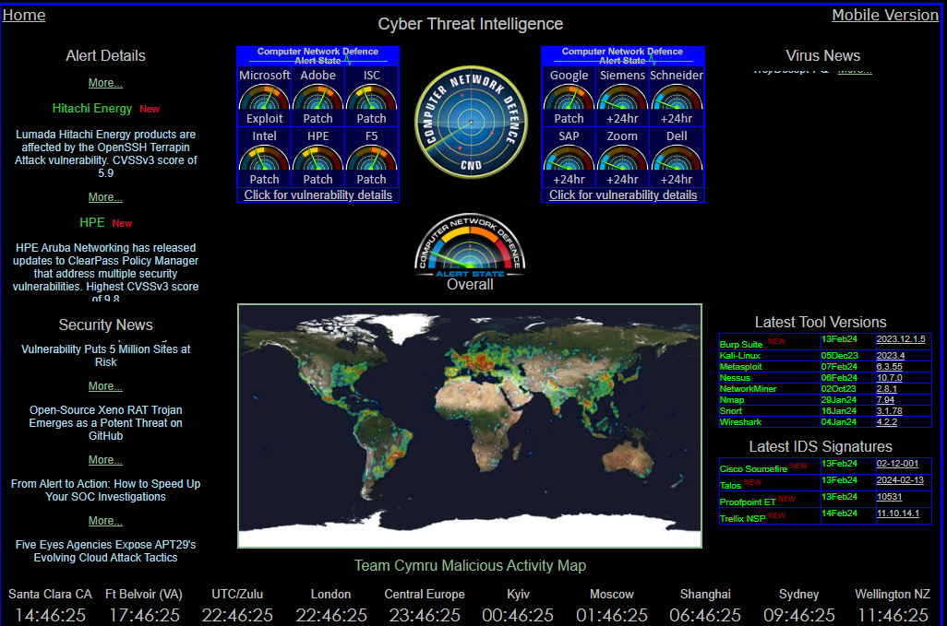
Vulnerability tracking services
https://radar.securitywizardry.com/

Slide 13
Network Scanning VS Vulnerability Scanning
Network Scanning
Scans a network to find active hosts and services available
Vulnerability Scanning
Scans a network or single system to look closely at the hosts and services in an effort to find configuration errors or known vulnerabilities
*Can also utilize “agent-based” scanning on hosts that are air- gapped and not available for network based scanning

Slide 14
What’s a webserver?
Physical System* (could VM, container)
Processor, Memory, Storage
Operating System
Windows Server 2008, 2012, etc Red Hat Linux, Ubuntu Linux
Web Server Software
Internet Information Services, Apache, Oracle, Resin
Web Technology Software
PHP, ASP, Java, Cold Fusion, Perl, Python, Ruby
Does it use SSL?
Does it use a backend database?

Slide 15
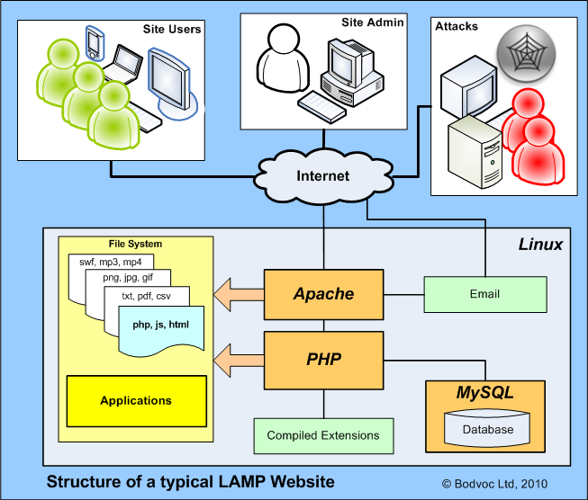
Typical LAMP Configuration
Linux
Apache
MySQL
PHP

Slide 16
Vulnerability Scanners
General Scanners
Free
MSBA
Secunia PSI
Nessus
OpenVAS
Paid
Nessus Pro
Secunia Enterprise
SAINT
Technology Specific Scanners
Free
Acunetix web scanner
WebSecurify web scanner
DPScan
WPScan
SQLMap
Paid
WebInspect
Acunetix

Slide 17
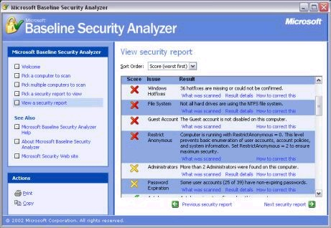
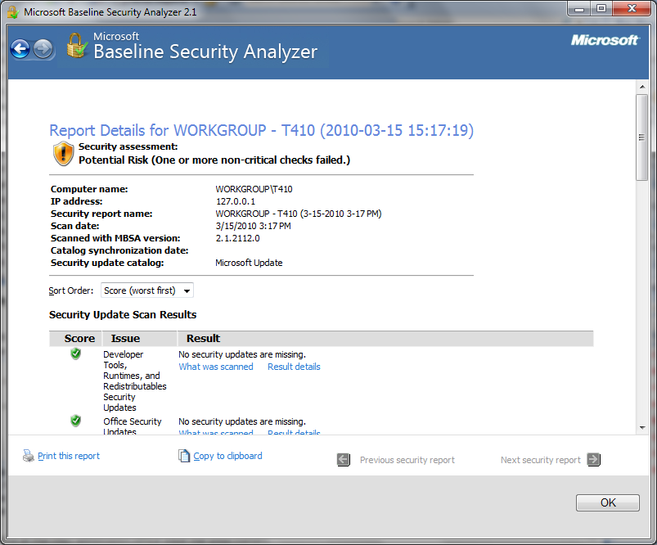

Microsoft baseline security analyzer (MBSA)

Slide 18
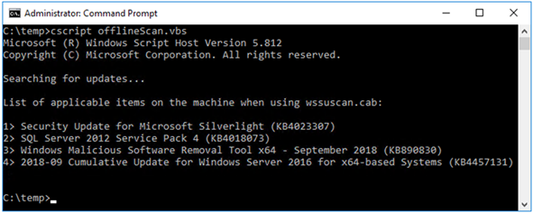
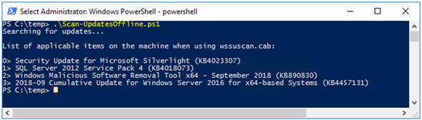
Microsoft Update Agent

Slide 19

Break

Slide 20
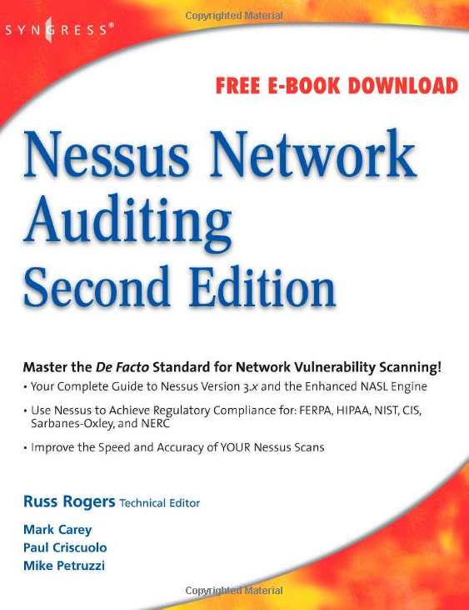
Nessus
First released in 1998 – initially open sourced
Later closed when Tenable became a commercial company
OpenVAS forked from last open-source version of Nessus
Client/server technology, available for multiple OS platforms
Plug-ins allow for modular architecture
Each vulnerability check is associated to a plugin, allows for selective checking
Thousands of plug-ins are available
Divided into categories:
-Backdoors -Remote Shell
-CGI Abuses -Gain Root Remotely
-Cisco -General
-Default Unix Accounts -Miscellaneous
-DoS -Netware
-Finger Abuses -P2P Filesharing
-Firewalls -RPC
-FTP -SMTP
-Windows / Linux -Useless Services
* Some plugins are considered dangerous

Slide 21
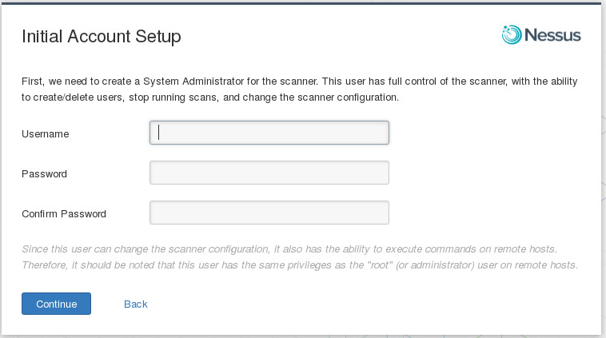
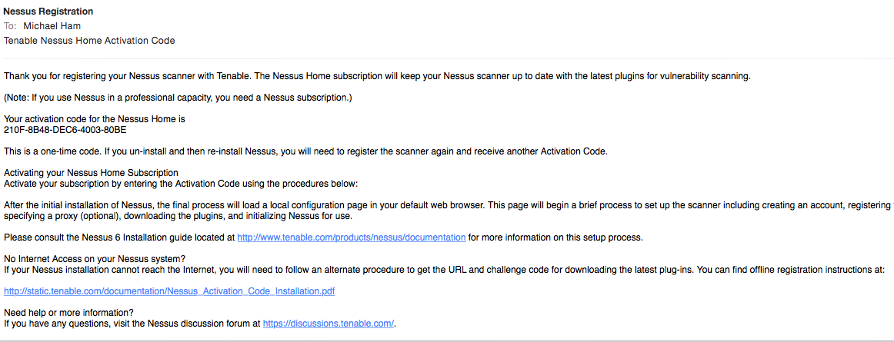
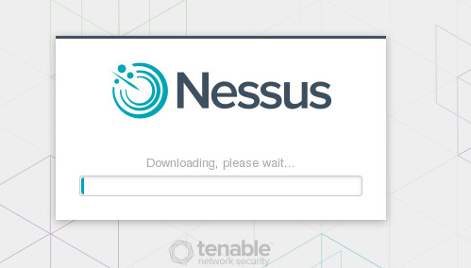
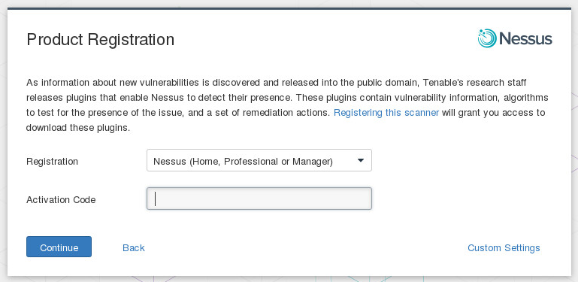
Nessus
Install Nessus into your system
Already installed in your Kali VM
Access the web application by navigating to the IP address of the system on port 8834 (default Nessus port)
Ignore any SSL errors from your browser
Follow the setup “wizard” / Register for Activation Code

Slide 22
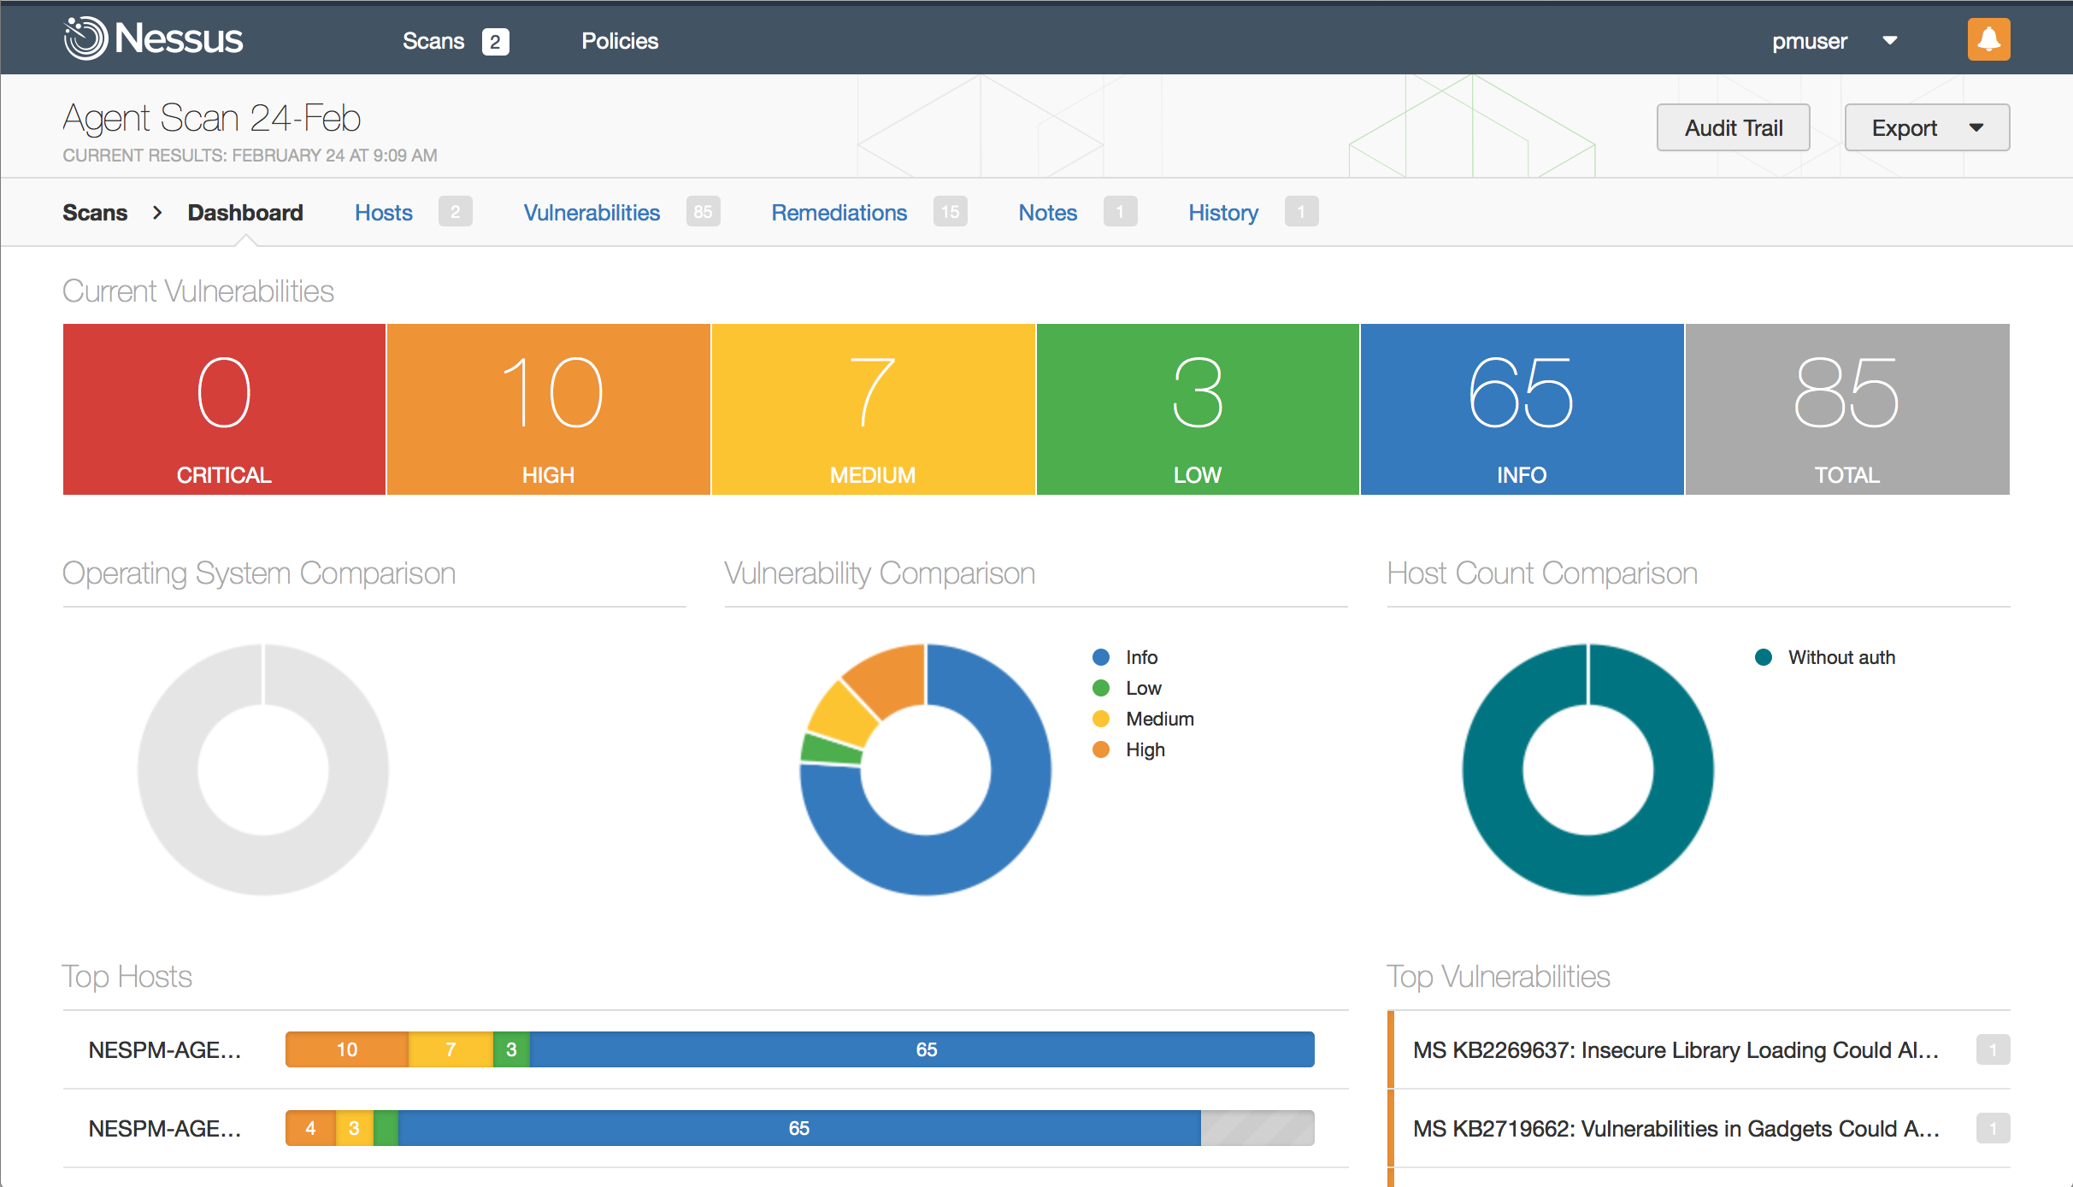
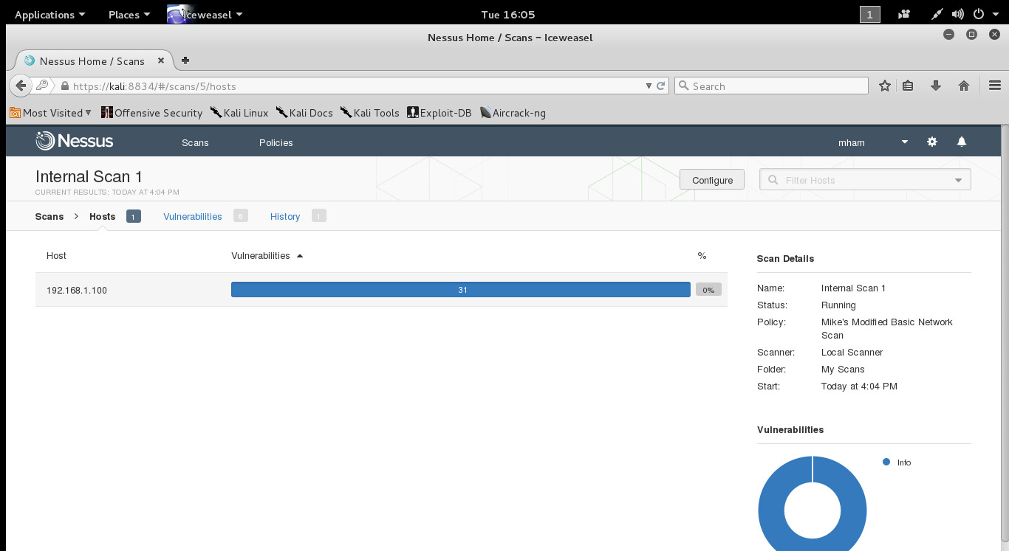
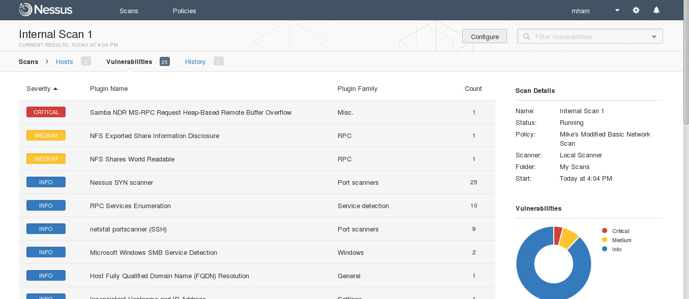
Nessus

Slide 23
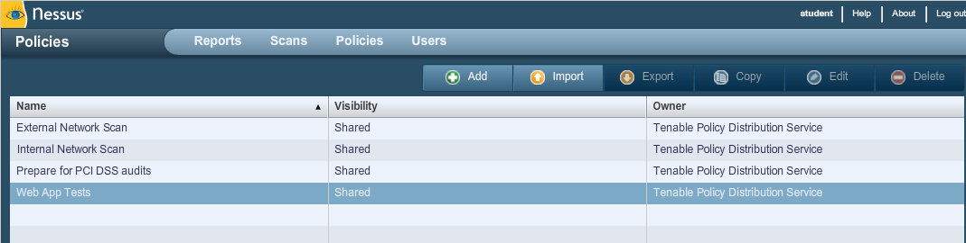
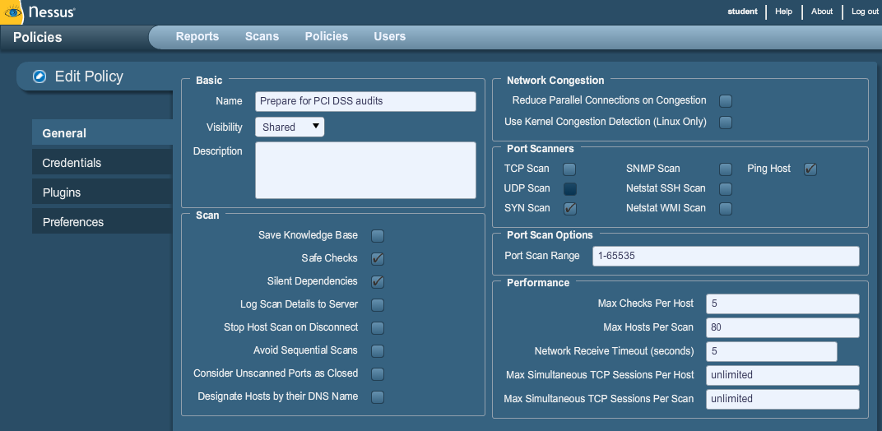
Nessus

Slide 24
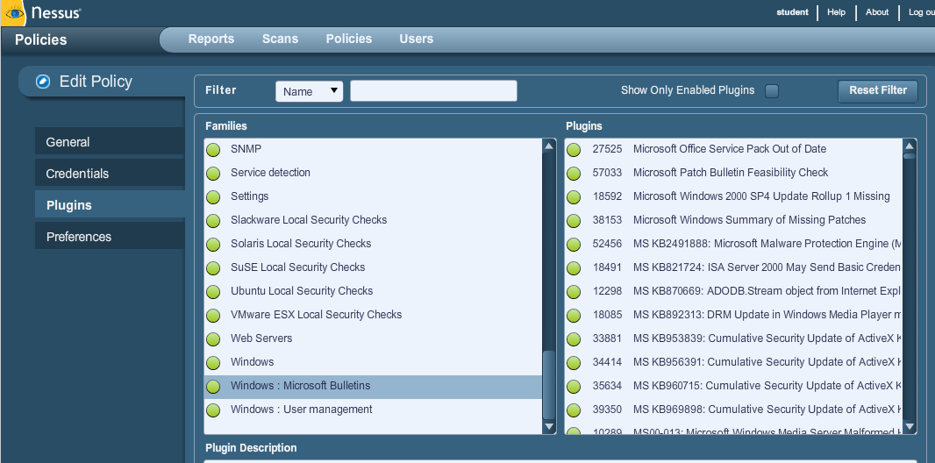
Nessus

Slide 25
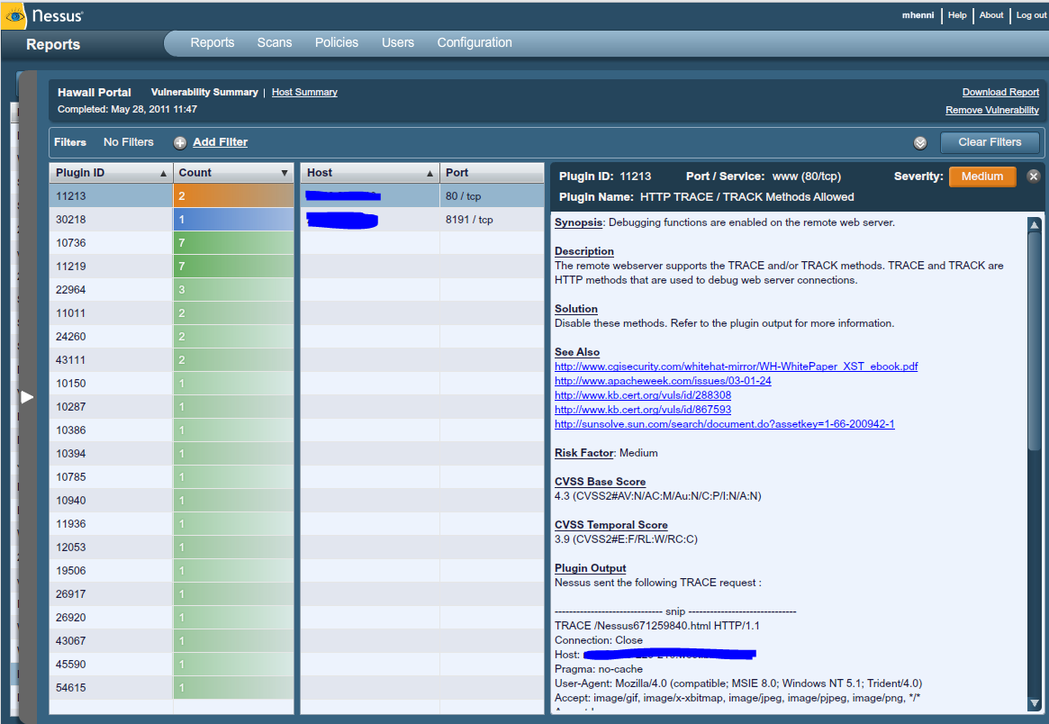
Nessus Report (1)

Slide 26
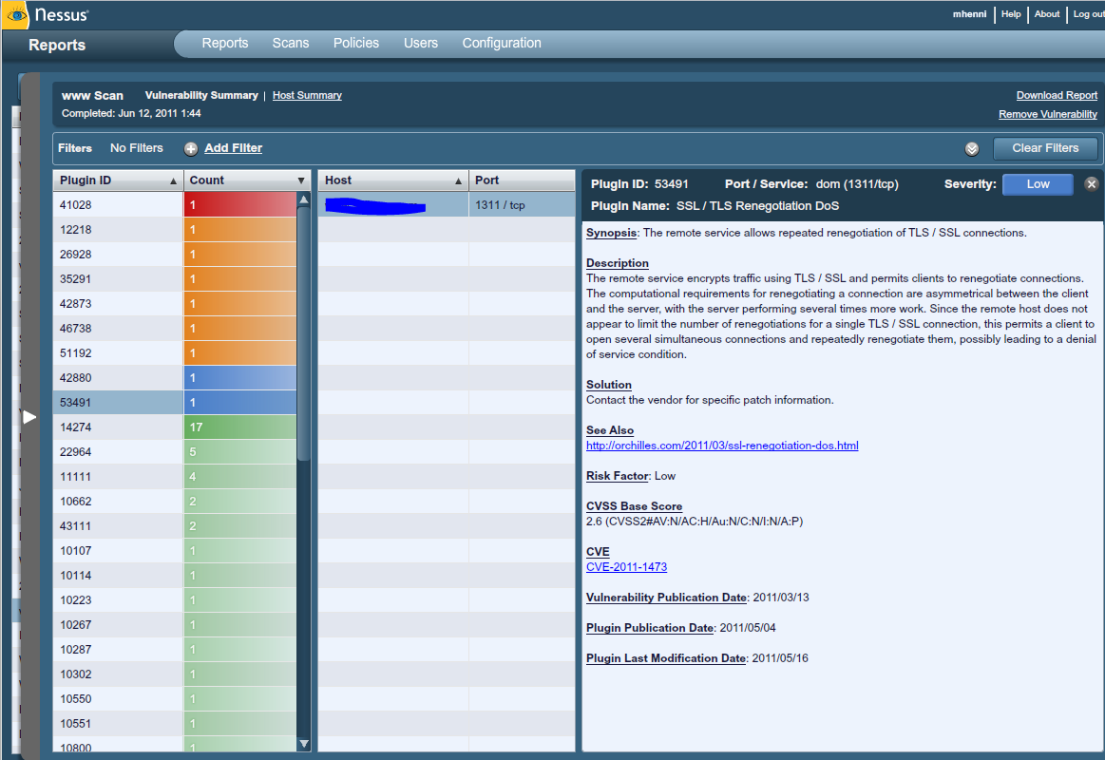
Nessus Report (2)

Slide 27
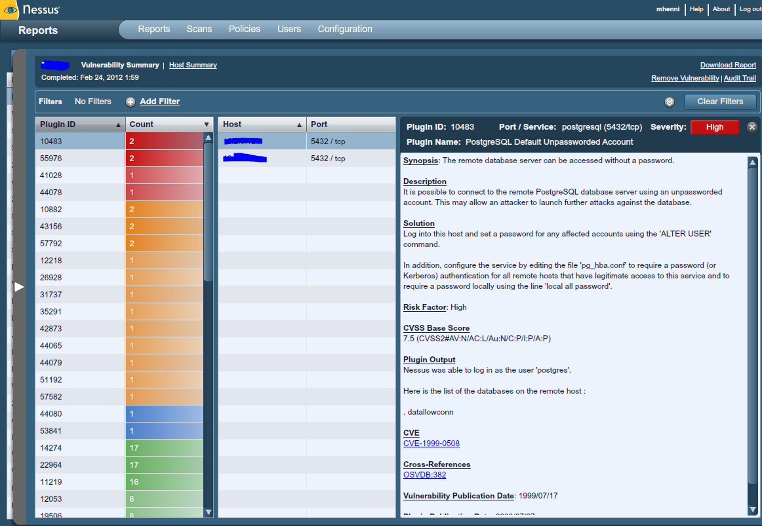
Nessus Report (3)

Slide 28
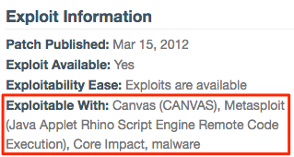
Nessus Report (4)

Slide 29
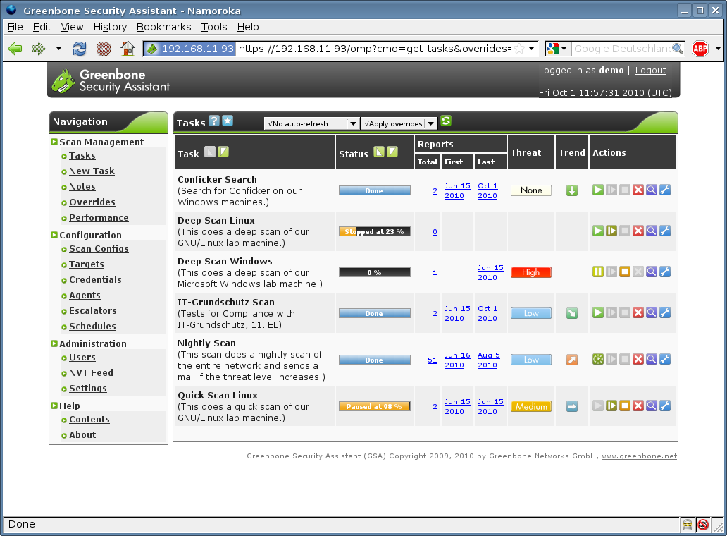
OpenVAS

Slide 30
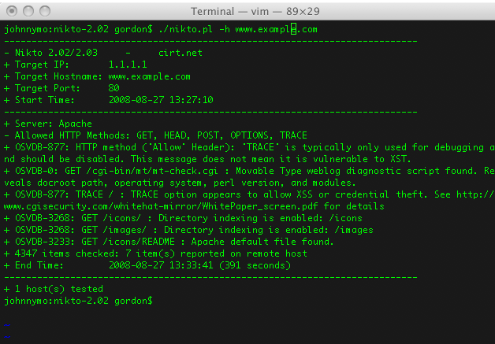
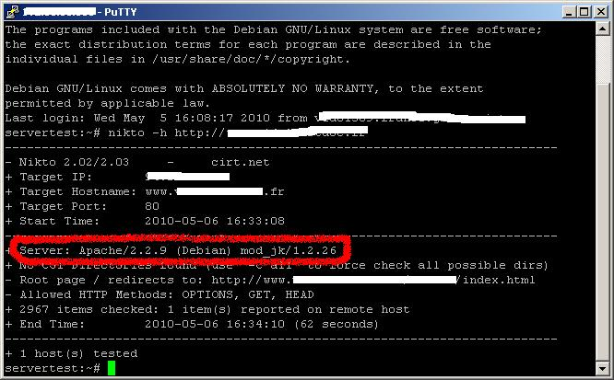
Nikto

Slide 31
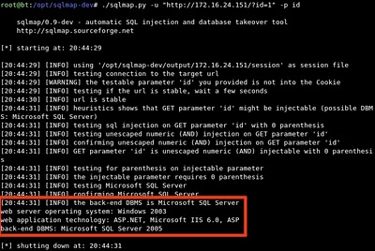
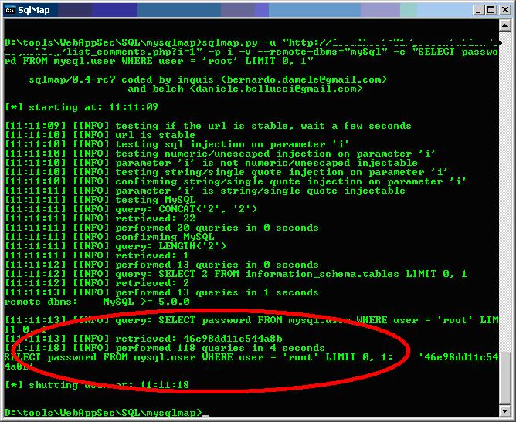
Sqlmap

Slide 32

Vulnerability Management
Cyclical Practice
- Identify
- Classify
- Remediate
- Mitigate
Also known as “Patch Management”
Only applies to known vulnerabilities, not Zero day vulnerabilities

Slide 33
Perspectives
Attacker Perspective
1. Identify vulnerabilities on your target to then use exploits against (Phase 3).
…LEARN…

Slide 34
Perspectives
Defender Perspective
1. Identify vulnerabilities on your systems BEFORE an attacker does.
…VERIFY…

Slide 35
Perspectives
Investigator Perspective
1. Question whether or not risk avoidance or risk acceptance was performed.
2. Compare incident forensics with vulnerability assessment reports.
…COMPARE…

Slide 36
Summary
What is a vulnerability
Vulnerability lists
Vulnerability Scanning
Vulnerability Management
Risk Management
Tools
Technology Specific Scanners
Free
Acunetix web scanner
WebSecurify web scanner
DPScan
WPScan
SQLMap
Paid
WebInspect
Acunetix
General Scanners
Free
MSBA
Secunia PSI
Nessus
OpenVAS
Paid
Nessus Pro
Secunia Enterprise
SAINT

Slide 37
Lab

